Slide 1
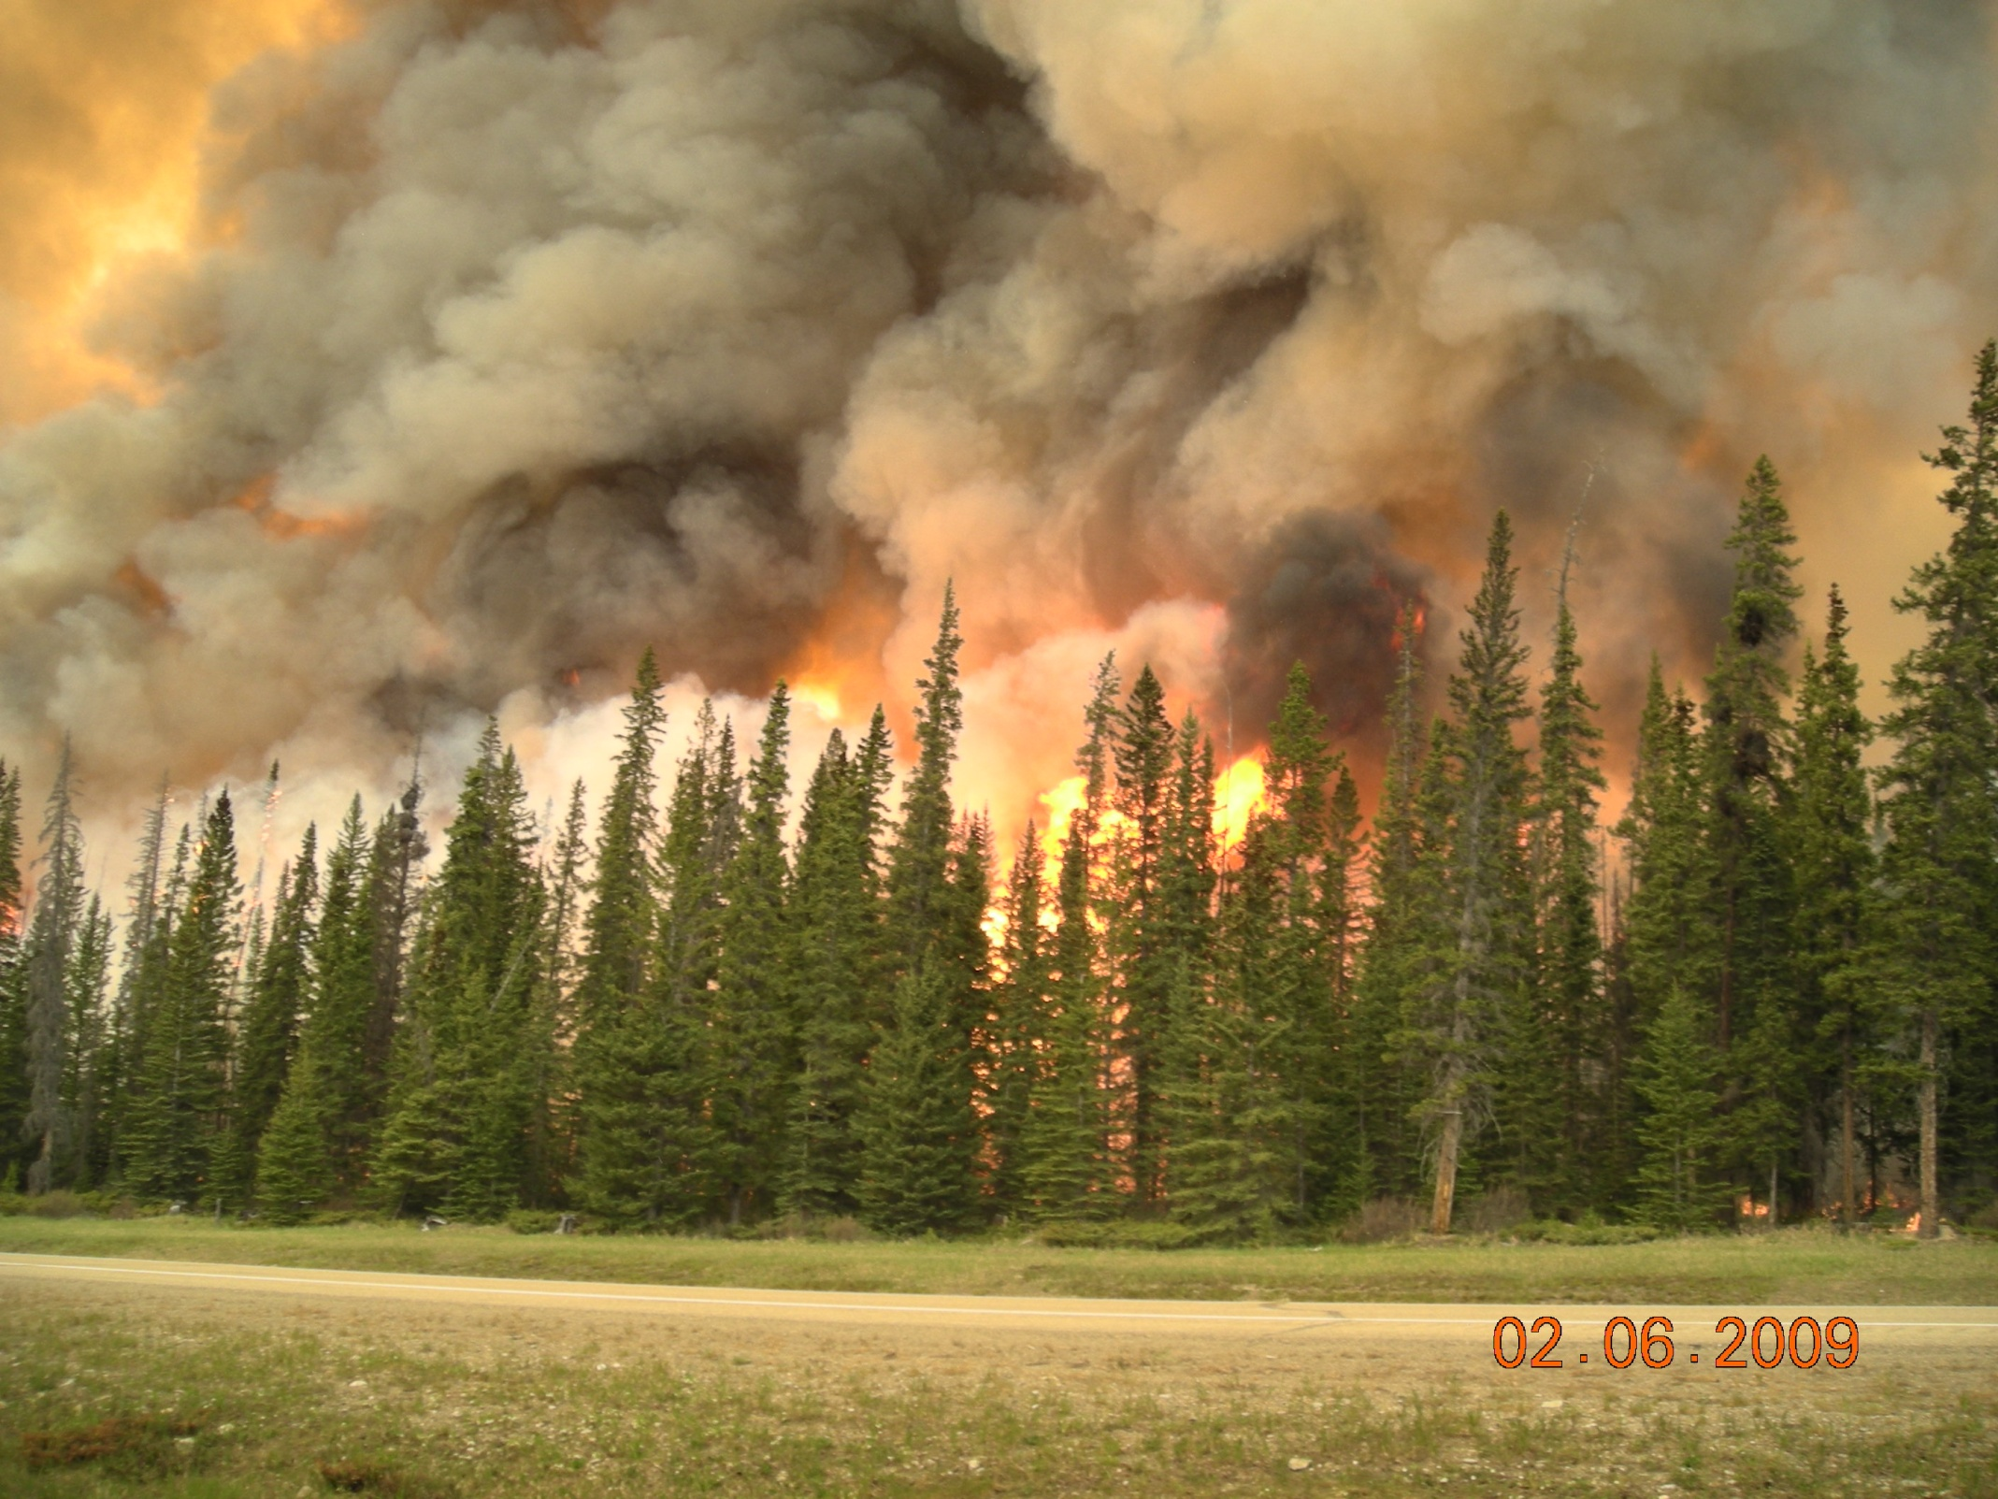
Decision support for strategic forest-fuels management in the Pacific Northwest
Keith Reynolds, Paul Hessburg, James Dickinson, Brion Salter
USDA-Forest Service, PNW Research Station, and
Robert Keane
USDA-Forest Service, Rocky Mtn Research Station

Slide 2
We present a DSS for the evaluation of severe wildfire danger
  Built with EMDS system
We demonstrate the system in the PNW Region
  but expansion to the CONUS is underway

Slide 3
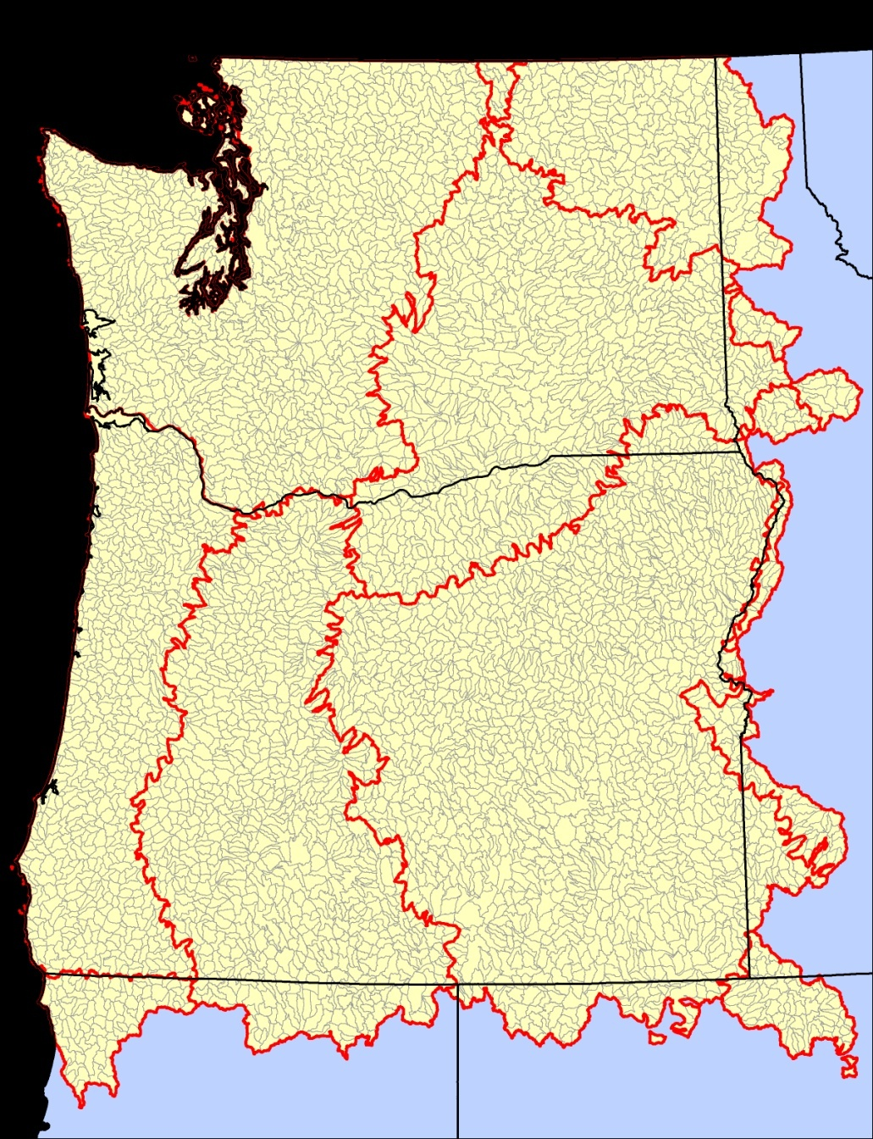
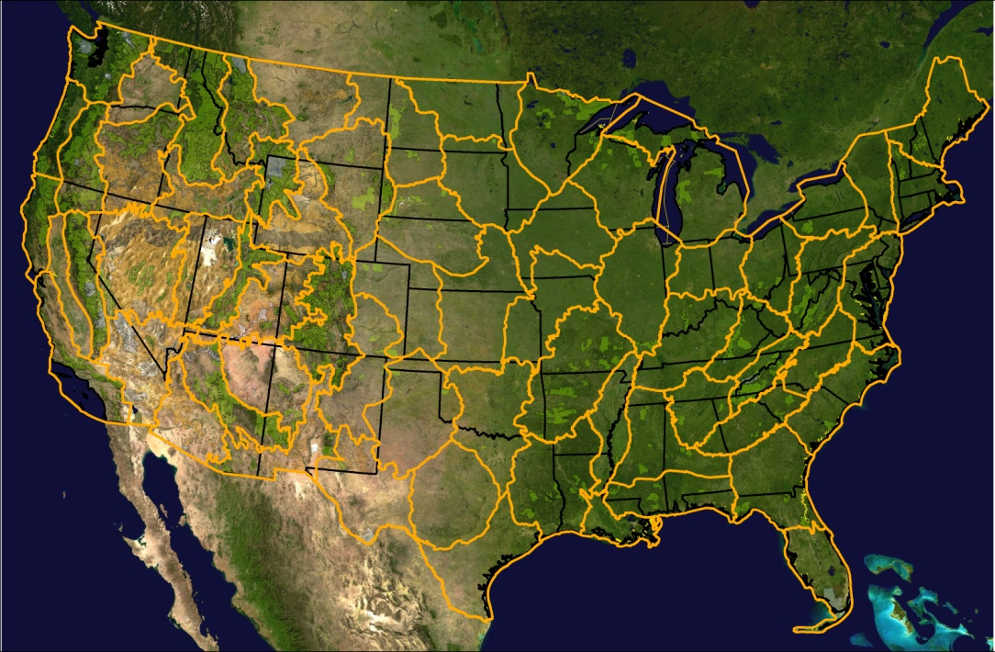
Subwatersheds: eval. unit
12 digit HUCs, USGS_NHD
5,052 subwatersheds in PNW
Average size: 8,637 ha
Total area: ~ 43.63 million ha
7 map zones
WA
EROS Data Center
ID
OR
CA
NV
LANDFIRE Map Zones: Biophysical land units (66) defined by similar landforms, land cover & natural resources

Slide 4
Outline
DSS consists of a logic model (NetWeaver) and a decision model (CriteriumDecisionPlus, CDP)
  Outline of logic
Summary of data sources
Logic model evaluates the existing state of each watershed with respect to fire danger
  Structural and behavioral variants
  Ensembles of behavioral variants
Decision model considers fire danger conditions in the context of other values/conditions to determine fuel treatment priorities for watersheds.

Slide 5
Logic model – basic outline
Fire danger
Fire hazard
Fire behavior (FIREHARM)
Ignition risk
Climate influence
Surface fuels
Crown fire potential
Lightning strikes
Drought
FBFM
Flame length
Fire density
KBDI
Canopy fuels
PDSI
Temperature
CBD
Above90
CBH
Degree Days
Curing
PCP Index
Con. No PCP
VaporDays

Slide 6
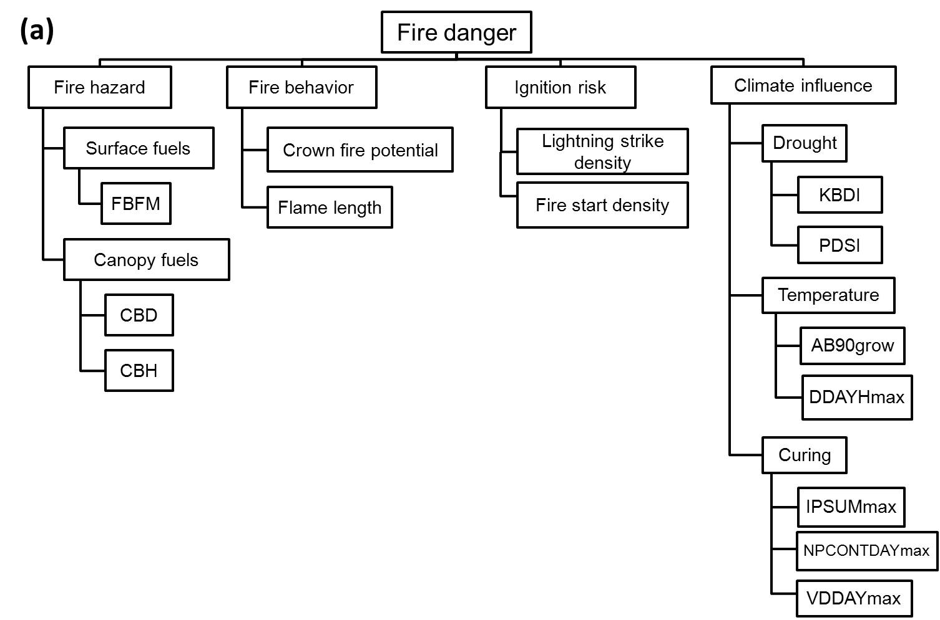

Slide 7
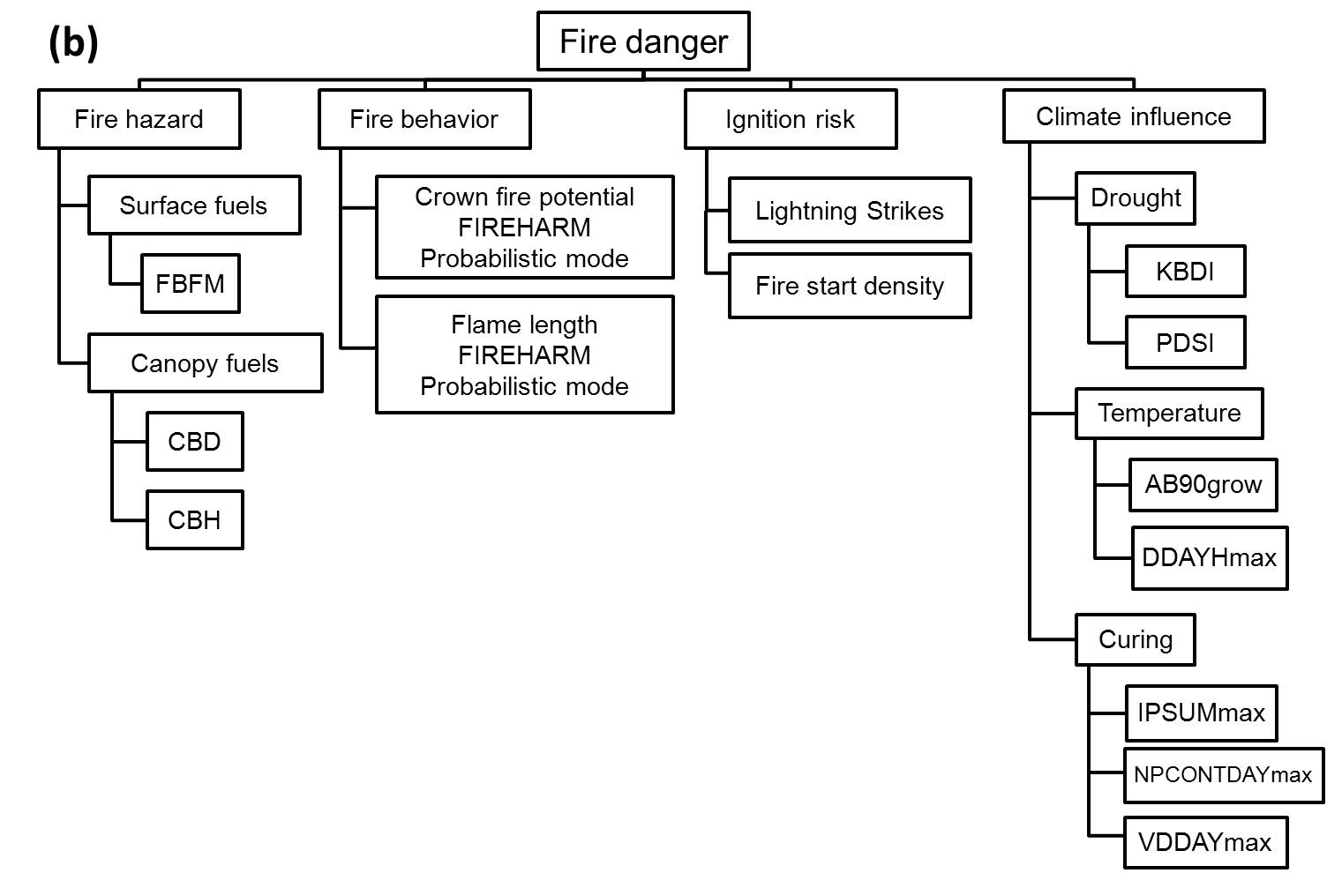

Slide 8
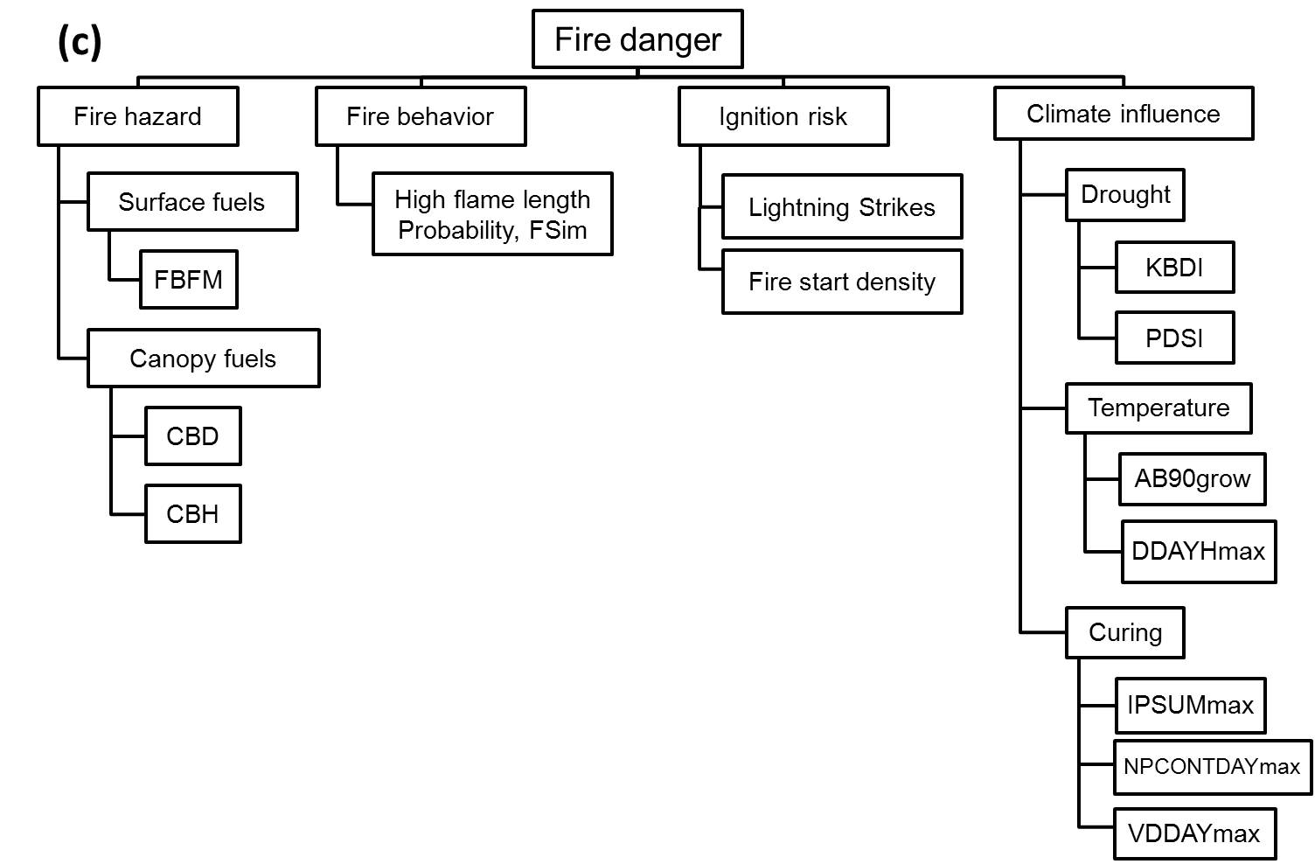

Slide 9


Slide 10
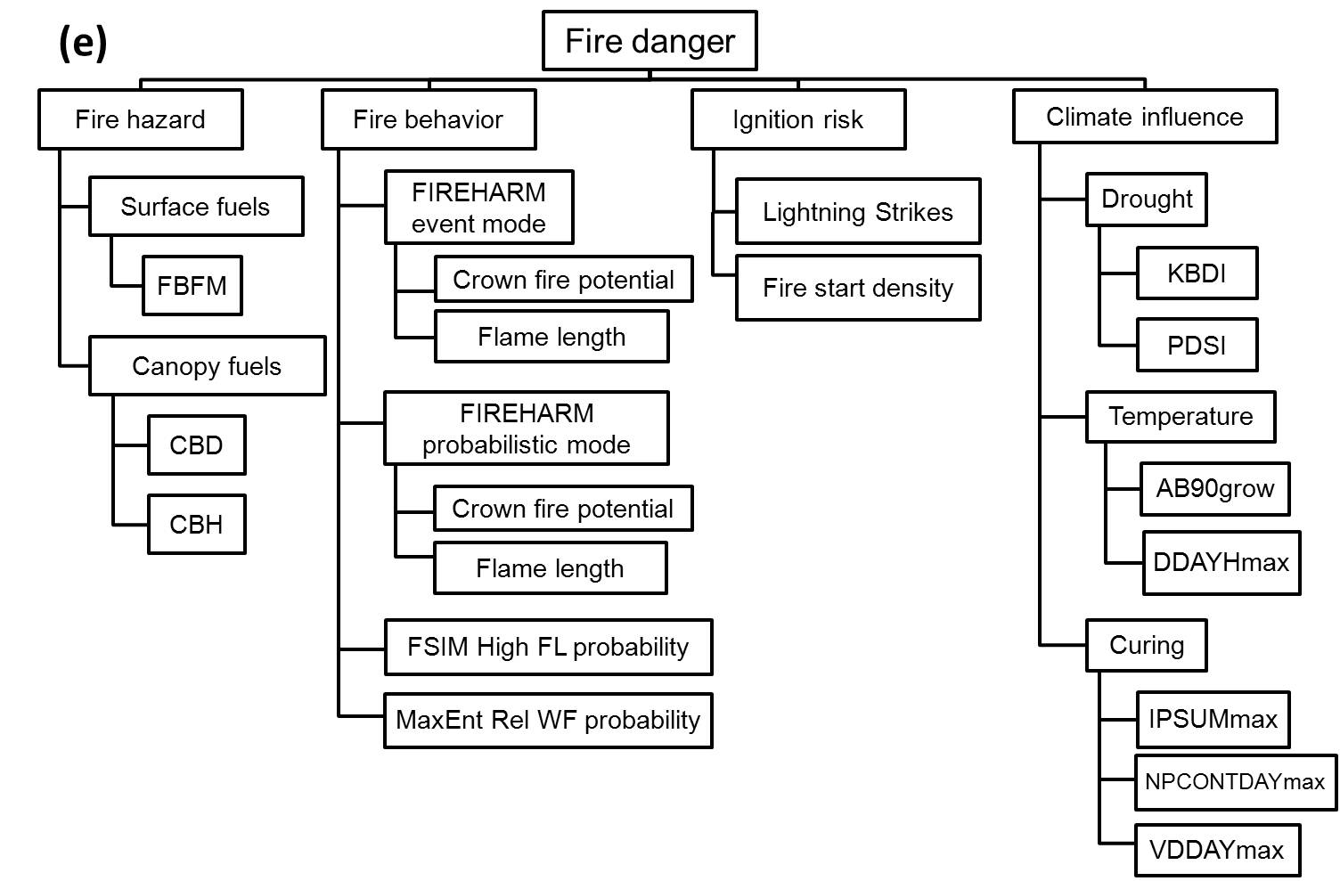

Slide 11
Data sources attributed to watersheds
Topic | Metrics | Source
Surface fuels | Fire behavior fuel models* | LANDFIRE
Canopy fuels | Crown bulk density*, crown base ht* | LANDFIRE
Fire behavior | Crown fire potential, flame length | FIREHARM
 | Burn probability, flame length | FSIM
 | Fire behavior statistic | Parisien MaxEnt full model
Ignition risk | Lightning strikes | National Lightning Detection Network
 | Fire density | Federal Wildland Fire Occurrence Database
Drought | Palmer Drought Severity Index | National Climate Data Center
 | Keetch-Byram Drought Index | FIREHARM
Temperature | Days > 90F, Mean DD heating > 64.4F | Climate Source via ORNL
Curing | Inverted precip for growing season, Ave max consecutive days w/o rain, Ave max days w/ vapor pressure deficit <1000 Pa | Climate Source via ORNL
*Metrics are an index, combining percent land area and
an aggregation index from Fragstats

Slide 12
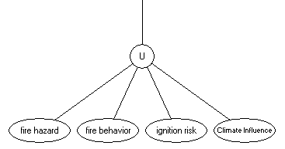
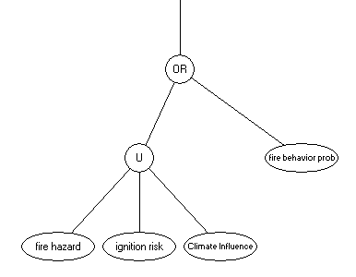
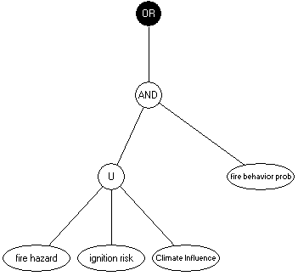
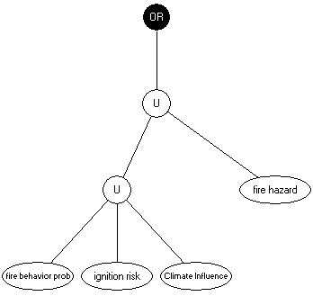
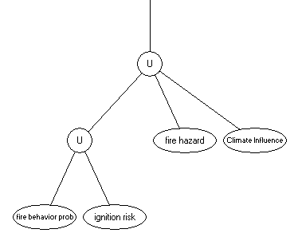
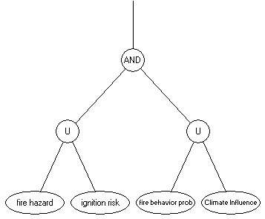
Six structural variants
Fire danger 1
Fire danger 2
Fire danger 3
(Preparedness)
Fire danger 4
Fire danger 5
Fire danger 6
(Fuel treatment)

Slide 13
Four behavioral variants and three ensembles
Behavioral variants
  FIREHARM, event mode (Keane)
  FIREHARM, probabilistic mode (Keane)
  Large fire simulator (Finney)
  Statistical model (Parisien MaxEnt MLA, full)
Ensembles of behavioral variants
  AND (limiting factors)
  UNION (compensating factors)
  OR (least limiting)
  These are a logical analog to confidence limits

Slide 14
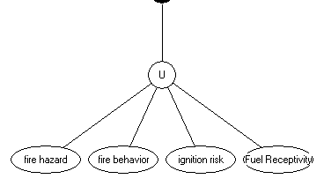
Level 1 Evaluation – Propositions (all take the null form)
Fire danger Danger of a severe wildfire is low. | fire hazard vegetation and fuel conditions within the watershed do not support a severe wildfire.
 | fire behavior expected fire behavior within the watershed is not severe.
 | ignition risk likelihood of a wildfire ignition within the watershed is low.
 | climate influence Weather and climate data do not support severe wildfire.
Fire danger
U
Climate
influence

Slide 15
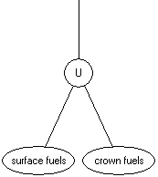
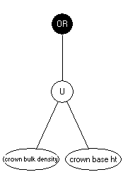
Level 2 Evaluation – Propositions (null form)
Fire hazard | surface fuels Condition of surface fuels not conducive to severe wildfire in the watershed fire behavior fuel model (FBFM)*; H is FM>9 (AIPL of High), using the Scott and Burgan FBFM40
 | canopy fuels Condition of crown fuels not conducive to severe wildfire in the watershed canopy bulk density (CBD)*; H >0.15 kg/m³ canopy base height (CBH)*; H < 2.0 m (AIPL of High)
 | AIPL evaluates the %area and degree of aggregation of that area w/ values of “High”
fire hazard
* Data layers (30-m pixel resolution) from LANDFIRE project at www.landfire.gov

Slide 16
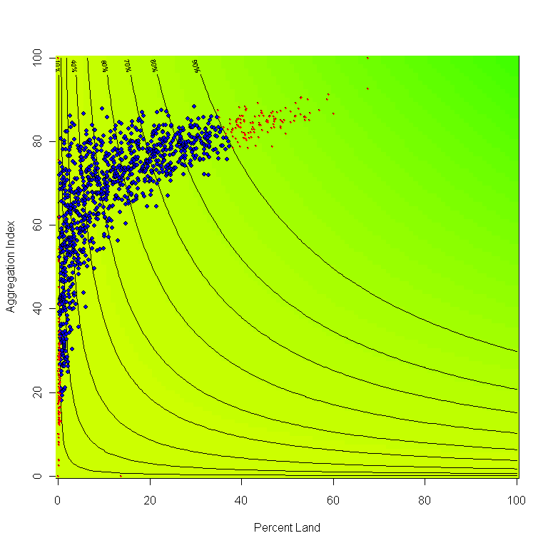
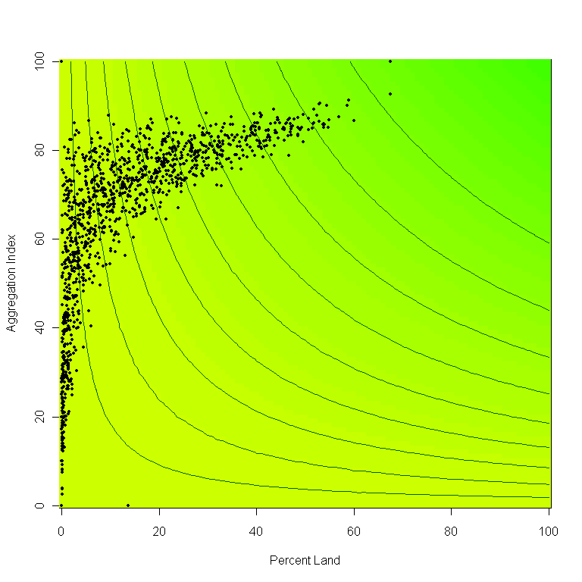
Values above/below either MIN and MAX are interpolated from a ramp function of the associated index.
Full
Support
MAX
(no support)
None
10%
90%
AIPL value
Median 80% range of AIPL of “High” CBD
With increasing AIPL of High CBD, we see decreasing support for the premise that crown fuels do not support severe wildfire in the w’shed
MIN
(full support)
Notes:
The ramp function is constructed by regressing values of the aggregation index for the 575 subwatersheds onto the percentage area of High canopy bulk density. The ramp defines the median 80% range of the data for values of PL of High CBD. No and full support and defined above and below 1 SD of the population mean of Aggregation index for the 575 subwatersheds, respectively. Likewise, no and full support are defined above and below the median 80% range of the PL of High CBD data, respectively.

Slide 17
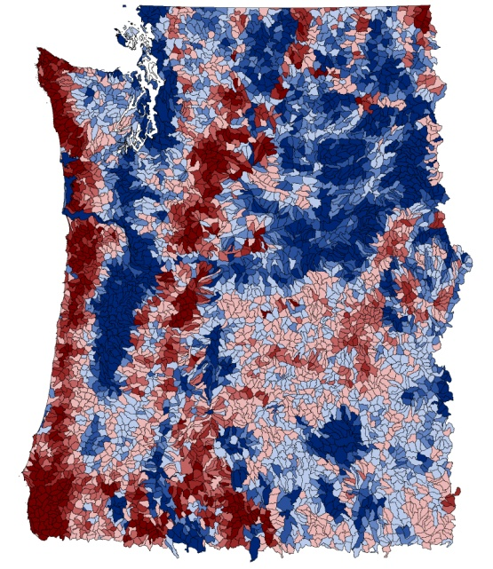
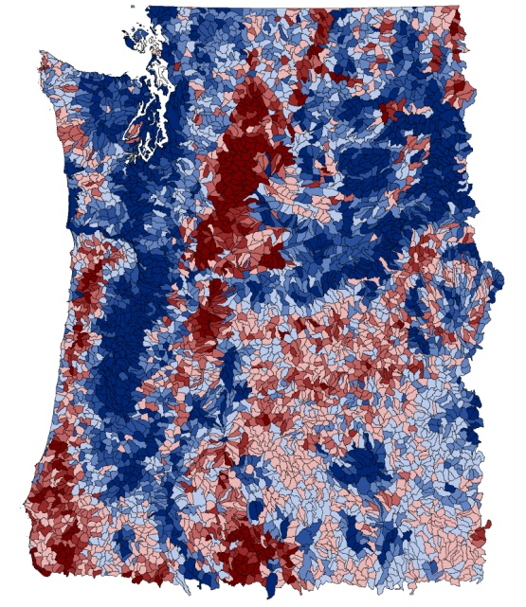
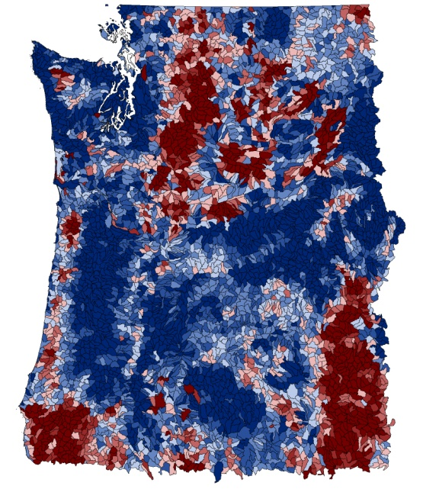
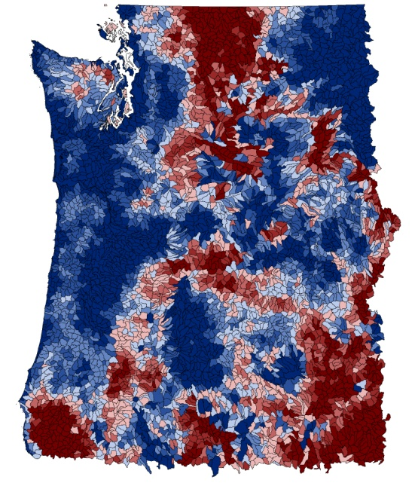
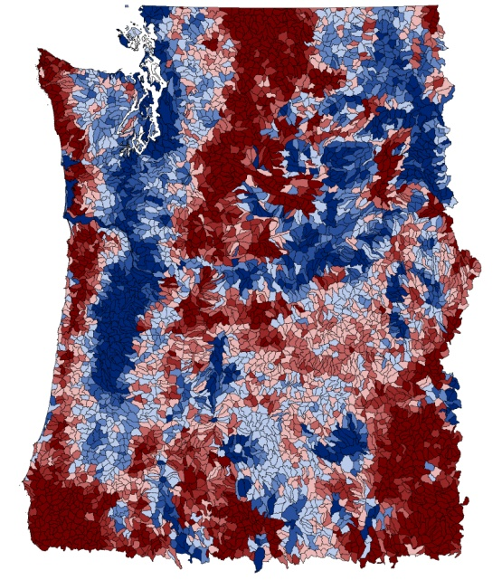
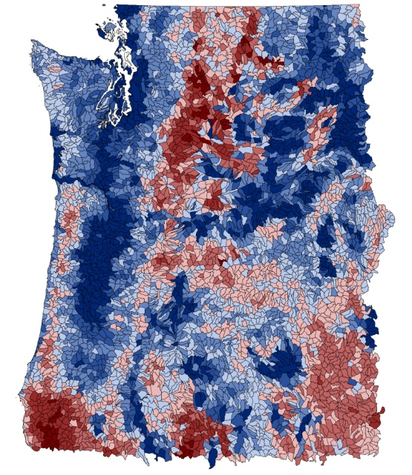
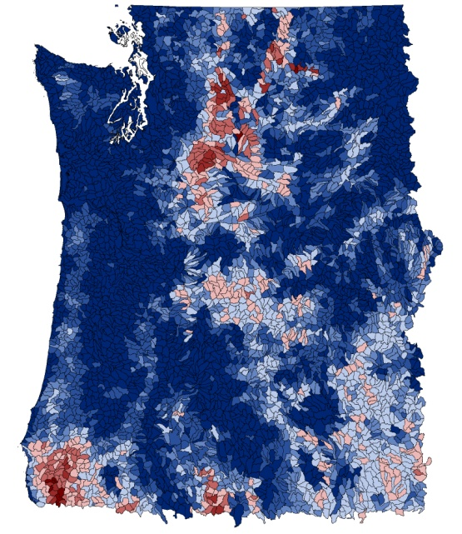
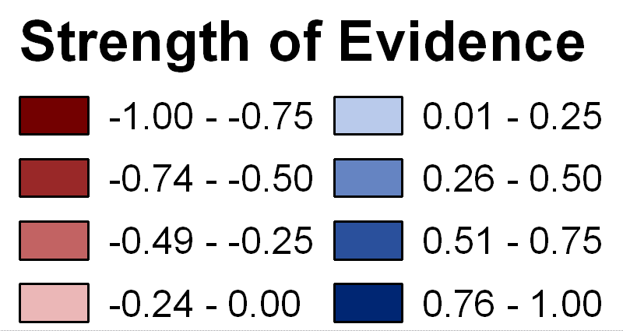
Fire Behavior
FIREHARM event
FIREHARM probabilistic
FSim
MaxEnt
Ensemble AND
Ensemble UNION
Ensemble OR

Slide 18
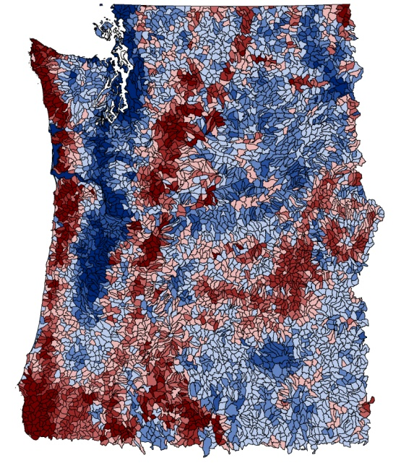
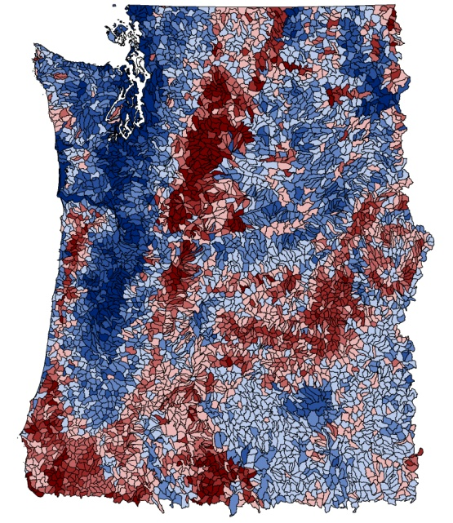
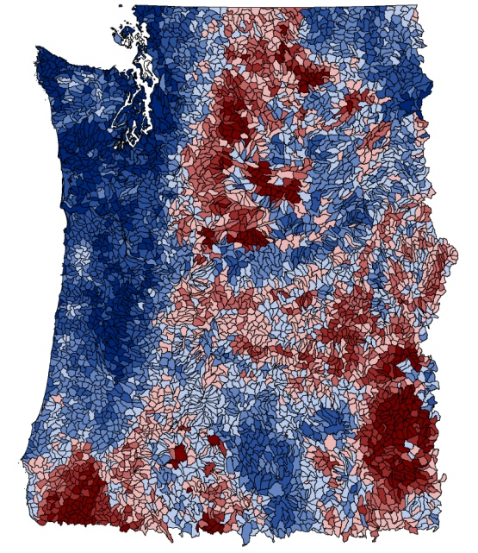
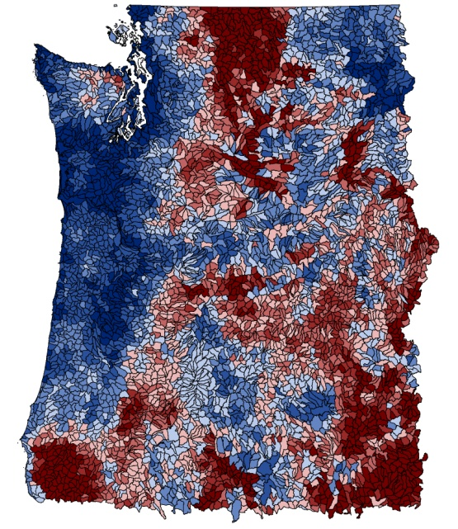
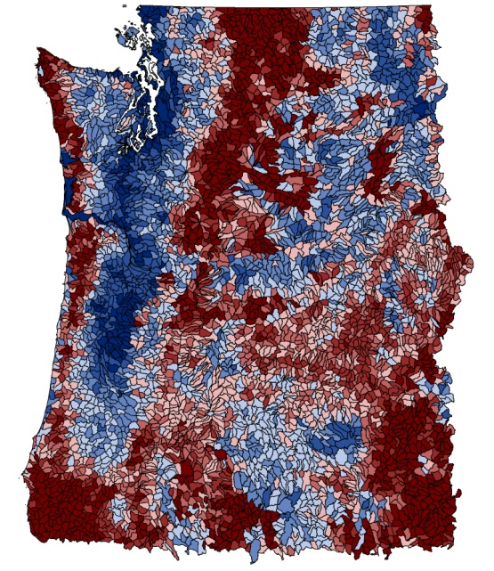
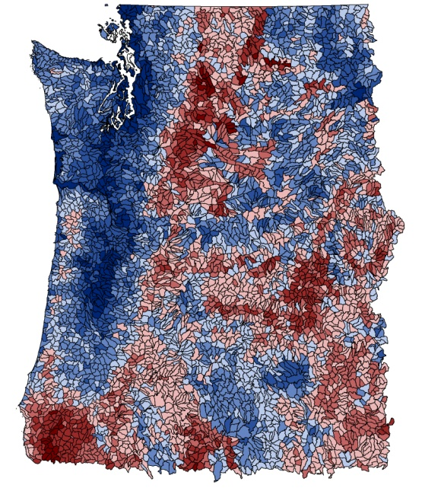
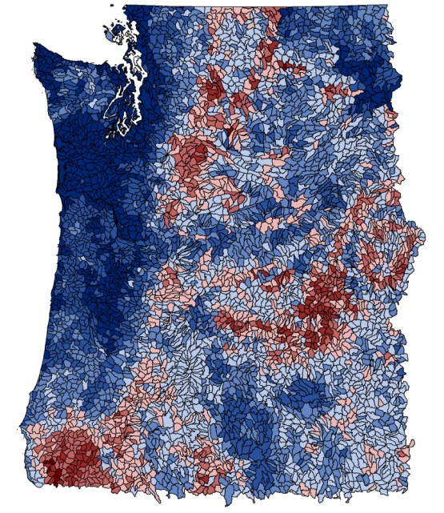
Fire Danger 3
FIREHARM event
FIREHARM probabilistic
FSim
MaxEnt
Ensemble AND
Ensemble UNION
Ensemble OR
Fire danger 3

Slide 19
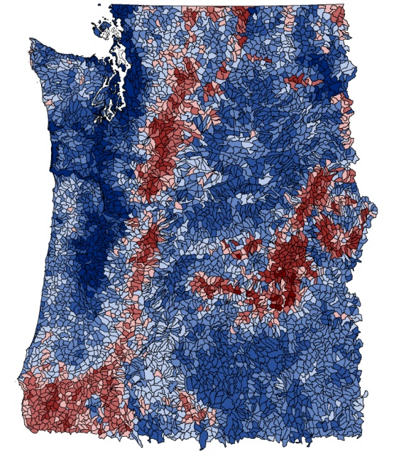
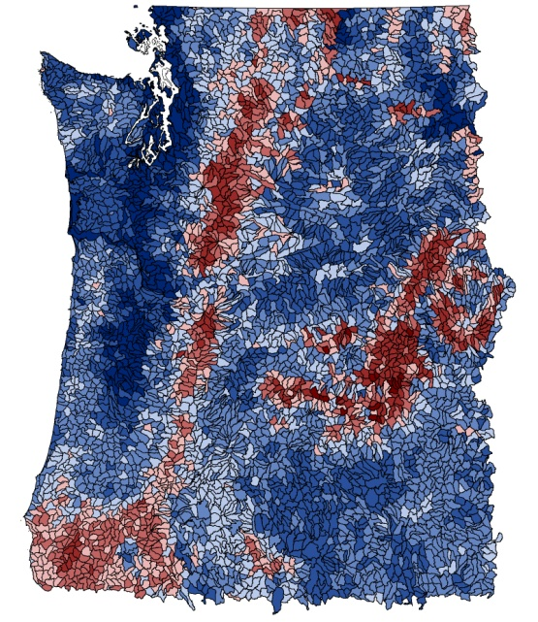
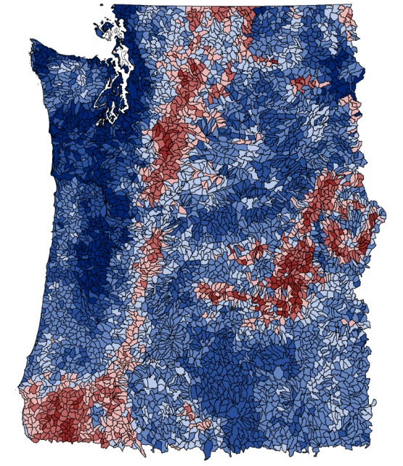
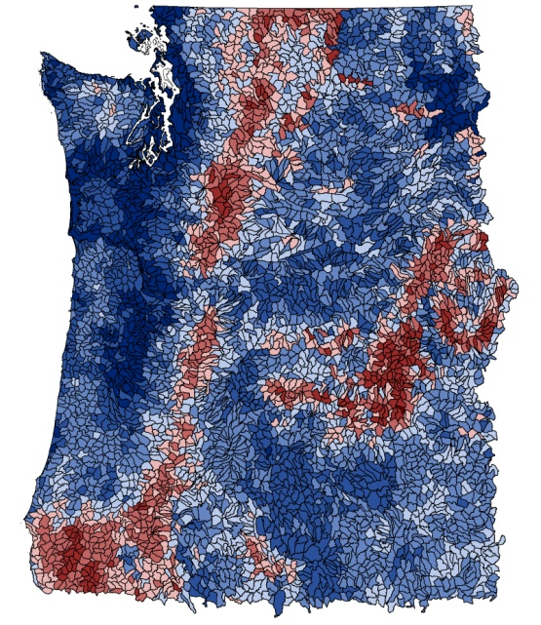
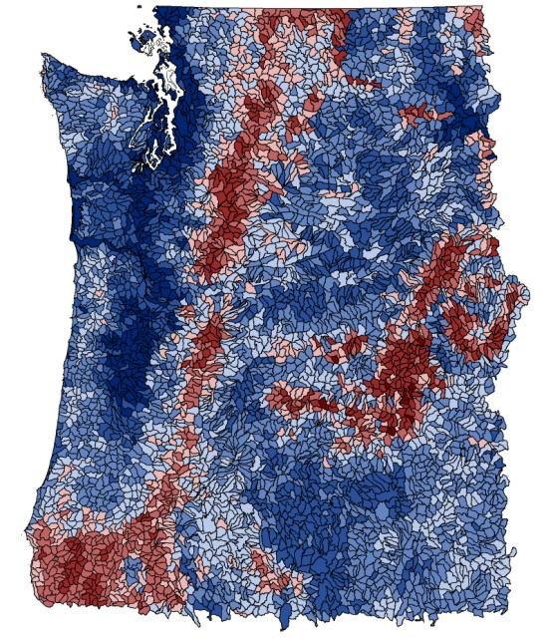
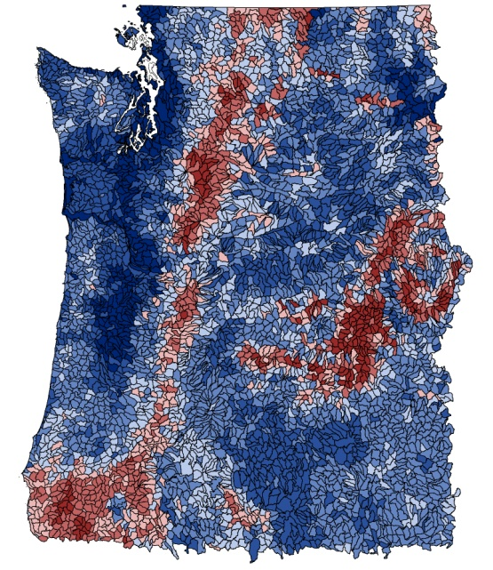
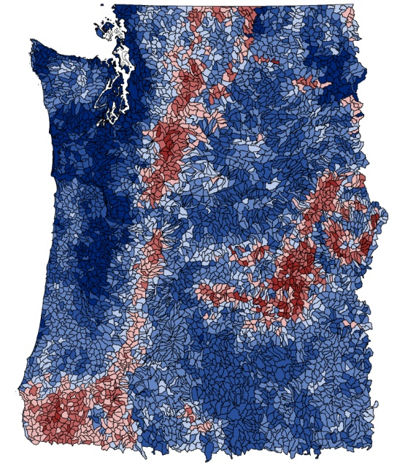
Fire Danger 4
FIREHARM event
FIREHARM probabilistic
FSim
MaxEnt
Ensemble AND
Ensemble UNION
Ensemble OR
Fire danger 4

Slide 20
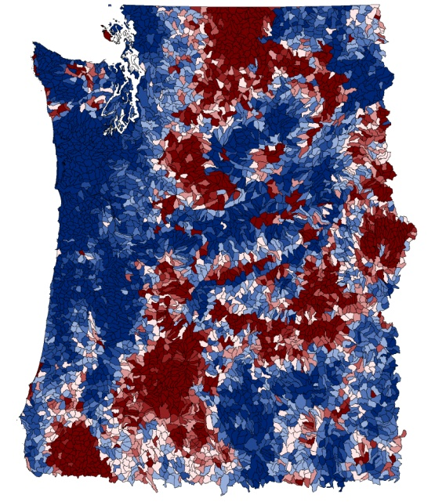
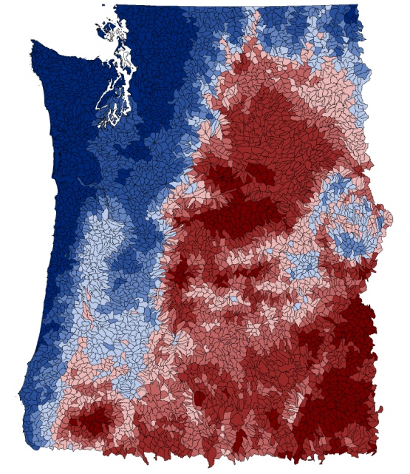
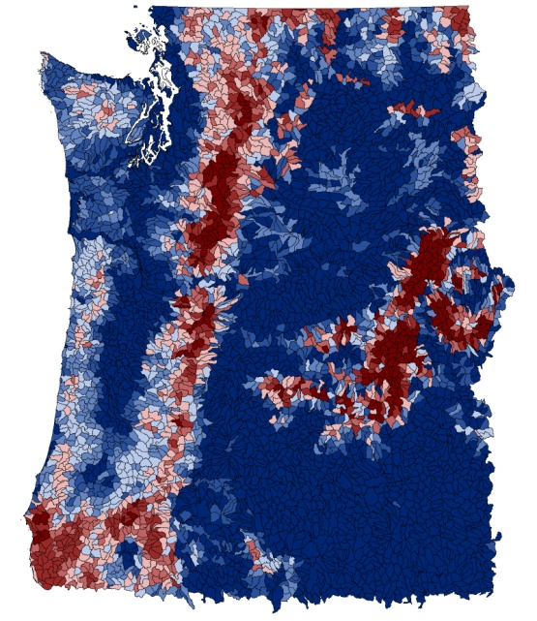
Fire Danger 4 with ensemble union
Fire danger 4
Fire Behavior
Ensemble UNION
Ignition Risk
Climate Influence
Fire Hazard

Slide 21
Decision model for fuel treatment
Decision criteria are the wildfire danger topics, threat to WUI, and biomass opportunity in a watershed.
Ensemble union,
structural variant 4

Slide 22
Additional data sources for decision model
Threat to WUI
  LANDSCAN 2006
      Percent subwatershed area in WUI Class 1 (Intermix, >= 1 house per 40 acres)
  FIREHARM event mode, threat class 3
    Fireline intensity, flame length, and rate of spread, exceeding high thresholds of
    400 kW·m⁻¹, 2m, and 5.0 km·hr⁻¹
Biomass
  FIA 2008, biomass within 500m of local and secondary roads
  Roads from 2010 Tiger Census and FS geodata road layers

Slide 23
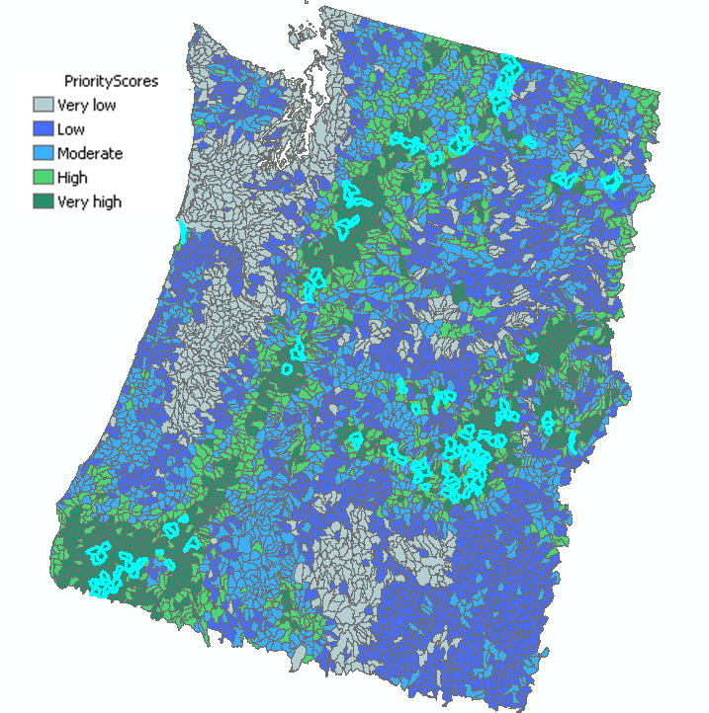
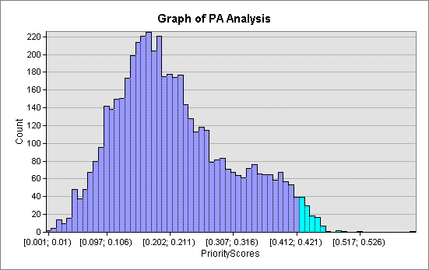
Priority scores from PA engine (CDP)
Highlighted region in histogram corresponds to selected watersheds in the map.
117 top-rated watersheds for fuel treatment priority (2.3%).

Slide 24
EMDS support for fuel treatment
The DSS provides a rational, transparent, repeatable process to prioritize watersheds for fuels treatments
The system is highly adaptable as available data, experience, and knowledge change
Contributions of variables & decision criteria to outcomes are transparent and known.
Mid-scale basis enables multi-scale
decision analysis by map zone, Dept,
agency, region, forest, district…
  Analyses can include all ownerships
  to support integrated cross-
  ownership decisions.
Current model addresses 7 map zones.
We are expanding to the CONUS.
WA
ID
OR
CA
NV

Slide 25
Financial and in-kind support:
Pacific Northwest Research Station
Rocky Mountain Research Station
USFS Region 6
National Fire Plan
LANDFIRE project

Slide 26
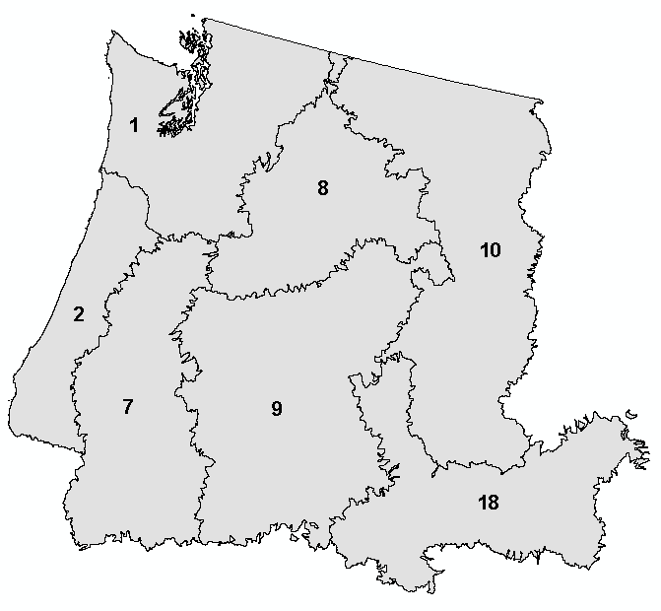
Correlations between behavior models
 | Map zone | N | FHprob | Parisien | FSIM
FHevent | 1 | 1037 | 0.649 | 0.022 | 0.136
 | 2 | 627 | 0.868 | 0.489 | 0.510
 | 7 | 822 | 0.702 | 0.318 | 0.259
 | 8 | 780 | 0.905 | 0.543 | 0.709
 | 9 | 1452 | 0.851 | 0.147 | 0.049
 | 10 | 274 | 0.766 | 0.108 | 0.147
 | 18 | 32 | 0.968 | 0.973 | 0.886
FHprob | 1 | 1037 |  | 0.418 | 0.663
 | 2 | 627 |  | 0.498 | 0.582
 | 7 | 822 |  | 0.375 | 0.556
 | 8 | 780 |  | 0.563 | 0.753
 | 9 | 1452 |  | 0.124 | 0.051
 | 10 | 274 |  | 0.135 | 0.022
 | 18 | 32 |  | 0.946 | 0.896
Parisien | 1 | 1037 |  |  | 0.653
 | 2 | 627 |  |  | 0.849
 | 7 | 822 |  |  | 0.334
 | 8 | 780 |  |  | 0.706
 | 9 | 1452 |  |  | 0.719
 | 10 | 274 |  |  | 0.499
 | 18 | 32 |  |  | 0.891
All Pearson correlation coefficients are significant at alpha = 0.01 except those in red.

